Slide 1
Review: What size reactor(s) to use?
Answers to this questions are based on the desired conversion, selectivity and kinetics
Kinetics
Reactor type &
size
Conversion
&
selectivity
Material &
energy
balances

Slide 2
Review: Rate Law for r_{j}
r_{A}: the rate of formation of species A per unit volume [e.g., mol/m^{3•}s]
-r_{A}: the rate of a consumption of species A per unit volume
1st order in A, 1st order in B, 2nd order overall
n^{th} order in A
Michaelis-Menton: common in enzymatic reactions
r_{j} depends on concentration and temperature:

Slide 3
Review: Basic Molar Balance (BMB)
F_{j0}
F_{j}
G_{j}
System volume
Rate of flow of j into system
Rate of flow of j out of system
Rate of generation of j by chemical rxn
Rate of decomposition of j
-
+
-
=
Rate of
accumulation
If the system is uniform throughout its entire volume, then:
Moles j generated per unit time (mol/s)
Moles generated per unit time and volume (mol/s•m³)
Volume
(m³)
=

Slide 4
Review: BMB Equations
F_{j0}
F_{j}
G_{j}
System volume
-
In
Out
Generation
Accumulation
+
=
Next: Apply BME to ideal batch, CSTR, & PFR reactors

Slide 5
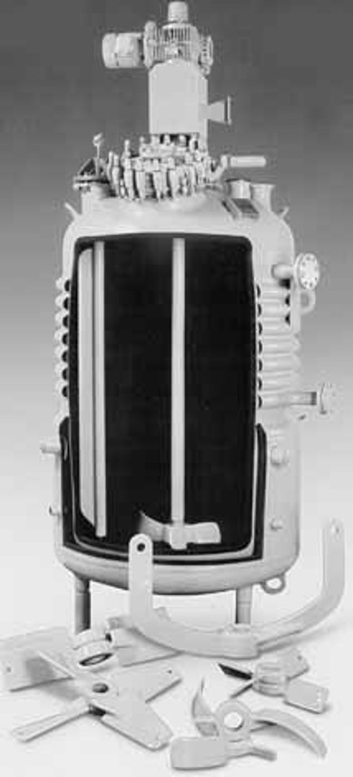
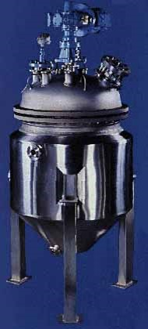
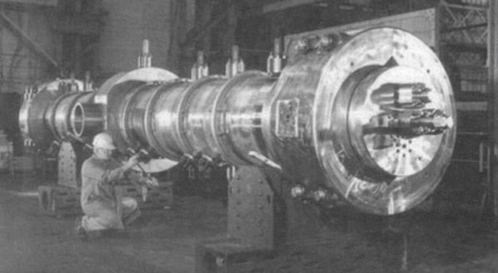
L2: Reactor Molar Balances & Considerations
F_{j0}
F_{j}
G_{j}
reactor
Today we will use BMB to derive reactor design equations. Your goal is to learn this process, not to memorize the equations!

Slide 6
Batch Reactors Properties
Reactants are placed in the reactor, and the reaction is allowed to proceed for some amount of time
Closed system- no addition of reactants or removal of products during the reaction
Unsteady-state conditions- the composition changes with time
Ideal batch reactor- vessel is perfectly mixed
Concentration and temperature are spatially constant, but NOT constant in TIME

Slide 7
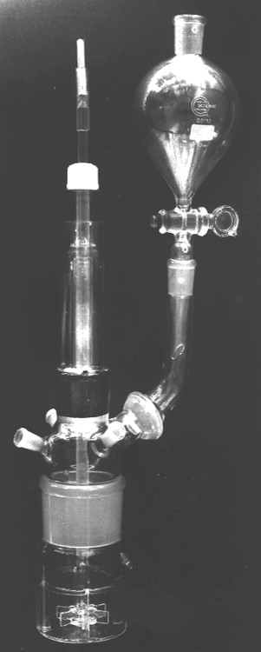
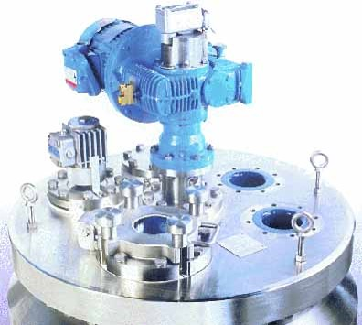
Examples of Batch Reactor
Lab-Scale Batch Reactor
Typical Commercial Batch Reactor
Motor for agitation

Slide 8
Basic Mole Balance for Batch Reactor
No flow in or out!
-
In
Out
+
Generation
Accumulation
=
X
X
F_{j0}
F_{j}
0
0
Batch Reactor Design Equation
If the reactor is perfectly mixed, the temperature, concentration, & therefore the reaction rate are spatially constant:
Ideal Batch Reactor Design Equation

Slide 9
Continuous Stirred Tank Reactor (CSTR) Properties
Continuously add reactants and remove products (open system)
Inlet stream instantaneously mixes with bulk of reactor volume
Ideal batch reactor- assume perfect mixing occurs in vessel
Temperature and concentration are uniform throughout space
Composition of the exit stream is the same as that inside reactor (C_{A,outlet} = C_{A, tank})
Steady-state conditions- the reaction rate is the same at every point and does not change with time

Slide 10
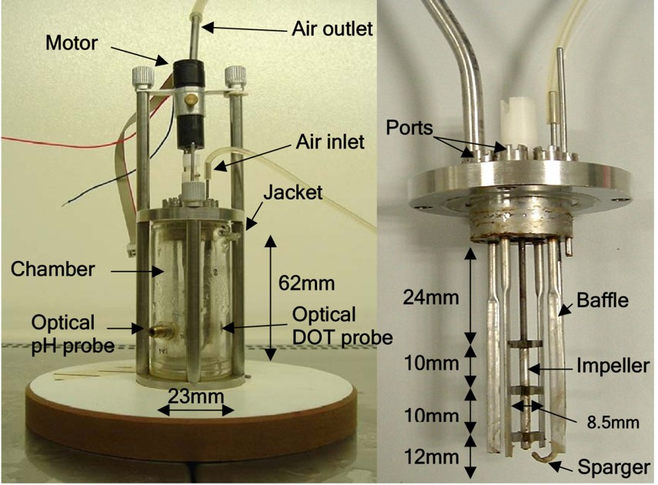
Examples of CSTRs
Laboratory-Scale Bioreactor
Pfaudler Inc.

Slide 11
Basic Mole Balance for CSTR
-
F_{j0}
F_{j}
In
Out
+
Generation
Accumulation
=
CSTR is at steady state (SS), so no change in moles j with time!
0
Steady State CSTR Design Equation
A perfectly mixed CSTR has no spatial variations in reaction rate
Rearrange to put in terms of V
r_{j} is measured at the outlet because C_{j,exit} = C_{j,tank}
Ideal Steady State CSTR Design Equation

Slide 12
Ideal SS CSTR Design Equation
Reactor volume required to reduce the entering flow rate of species j from F_{j0} to F_{j} at the outlet (and in the tank)
How do we determine the molar flow rate, F_{j} (units = mol/time)?
C_{j}: concentration of j υ: volumetric flow rate
Ideal SS CSTR design equation in terms of concentration:

Slide 13
Plugged Flow Reactor (PFR) Properties
Also called a tubular reactor
Cylindrical pipe with openings at both ends
Steady movement of material down length of reactor
Reactants are consumed as they flow down the length of the reactor
Operated at steady state:
No radial variation in temperature, concentration, or reaction rate
All fluid/gas elements have the same residence time

Slide 14
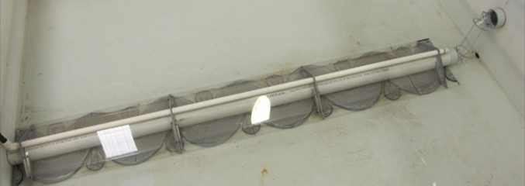
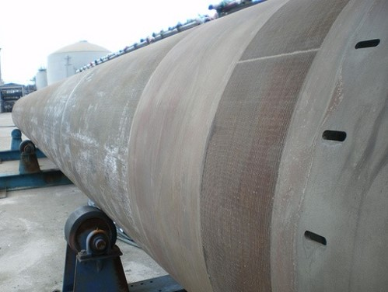
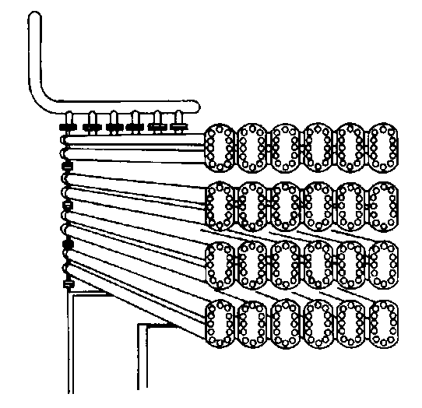
Industrial PFRs
Polyethylene reactor:
16 inch inner diameter
Operates at 35,000 psi & 600 °F
Has a vertical orientation when in use
Courtesy of Autoclave Engineers of Snap-tite, Inc.

Slide 15
Mole Balance – PFR
In a plug flow reactor the composition of the fluid varies from point to point along a flow path. Consequently, the material balance for a reaction component must be made for a differential element of volume ΔV
ΔV
F_{A0}
F_{A}
F_{j0}
-
F_{j}
+
=
Divide by ΔV
0
lim
ΔV→0
If we assume the PFR is ideal, the degree of completion is not affected by PFR shape, only by PFR volume
Ideal SS PFR Design Eq.

Slide 16
Packed Bed Reactors (PBR)
Cylindrical shell, vertically oriented
Often gravity-driven flow
Heterogeneous reaction: fixed bed of catalyst inside
Reactants enter top and flow through the packed bed of catalyst
Concentration gradient of reactant and product down the length of the reactor
Reaction occurs on the surface of the catalyst pellets
Reaction rate is based on the mass of the solid catalyst, W, not reactor volume V

Slide 17
Mole Balance- Packed Bed Reactor (PBR)
Similar to PFR, but we want to express it in terms of catalyst weight instead of reactor volume
Units for the rate of a homogeneous rxn (r_{j}) :
Units for the rate of a catalytic rxn (r_{j}’) :
So rewriting the PFR design equation in terms of catalyst weight instead of reactor volume:

Slide 18
Mole Balances on Common Reactors

Slide 19
Selection of Reactors
Batch
small scale
production of expensive products (e.g. pharmacy)
high labor costs per batch
difficult for large-scale production
CSTR: most homogeneous liquid-phase flow reactors
when intense agitation is required
relatively easy to maintain good temperature control
the conversion of reactant per volume of reactor is the smallest of the flow reactors - very large reactors are necessary to obtain high conversions
PFR: most homogeneous gas-phase flow reactors
relatively easy to maintain
usually produces the highest conversion per reactor volume (weight of catalyst if it is a packed-bed catalyze gas reaction) of any of the flow reactors
difficult to control temperature within the reactor
hot spots can occur

Slide 20
Uses for Various Reactors
Noncatalytic homogeneous gas reactor
Homogeneous liquid reactor
Liquid-liquid reactor
Gas-liquid reactor
Non-catalytic gas-solid reactor
Fixed bed
Fluidized bed
Fixed bed catalytic reactor
Fluid bed catalytic reactor
Gas-liquid-solid reactor
Ethylene polymerization
(high pressure)
Mass polymerization of styrene
Saponification of fats
Nitric acid production
Iron production
Chlorination of metals
Ammonia synthesis
Catalytic cracking (petroleum)
Hydrodesulphurization of oils

